Slide 1

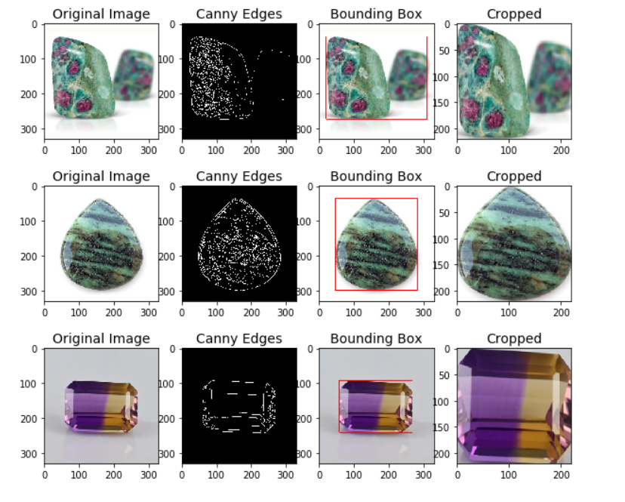
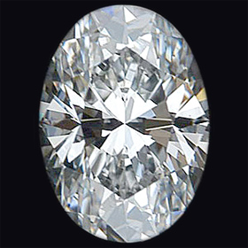
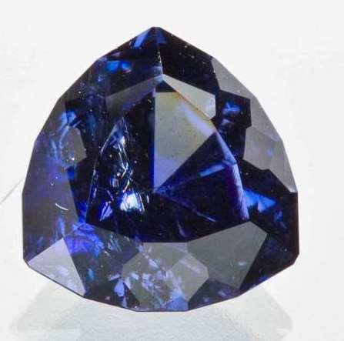
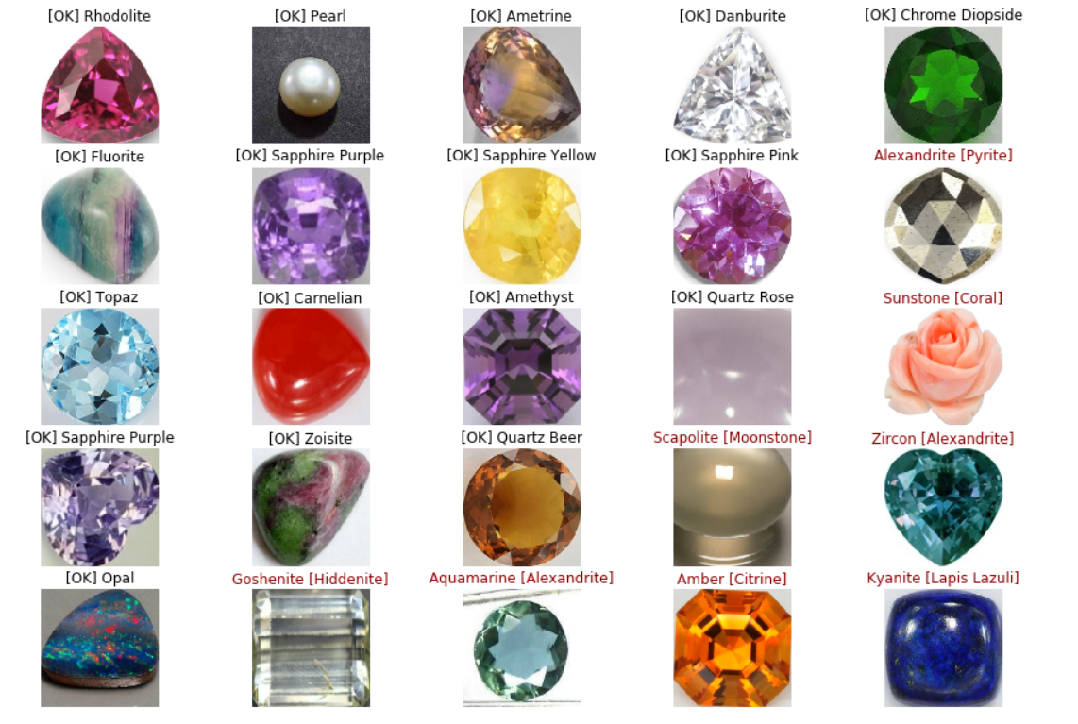
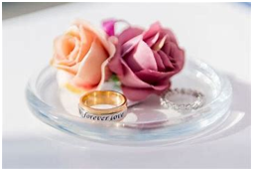
Image Detection and recognition in jewelry.
ENG EC601 Project by Orif Negmatov
Boston University College of Engineering https://github.com/Orif0007/EC601-Project
BACKGROUND
METHODS
RESULTS
Gemstone – piece of mineral crystal
Gemstones can be collected in a database to parse through
3-D scanner (such as LiDAR) can be utilized for gemstones
- iPhones have built-in LiDAR
Divide data into two components: training and test models
Create a function that reads the images
Crop edges of images using Canny algorithm
Design a test model using Convolutional Neural Network algorithm
OBJECTIVES
Identify gem’s name from an image
Analyze image processing algorithms
Allow a user to select a jewelry item or gem
Describe the properties of the item (diamond, sapphire, etc.) to the user
INPUT/TEST DATA
Achieved accuracy of 65%
NEXT STEPS
Design a mobile application that does image processing
- Detects the gemstone and shows the inventory of similar jewelry items
- Provides customers with options for purchase

